Slide 1
Your Personal Nutrition Assistant

Slide 2
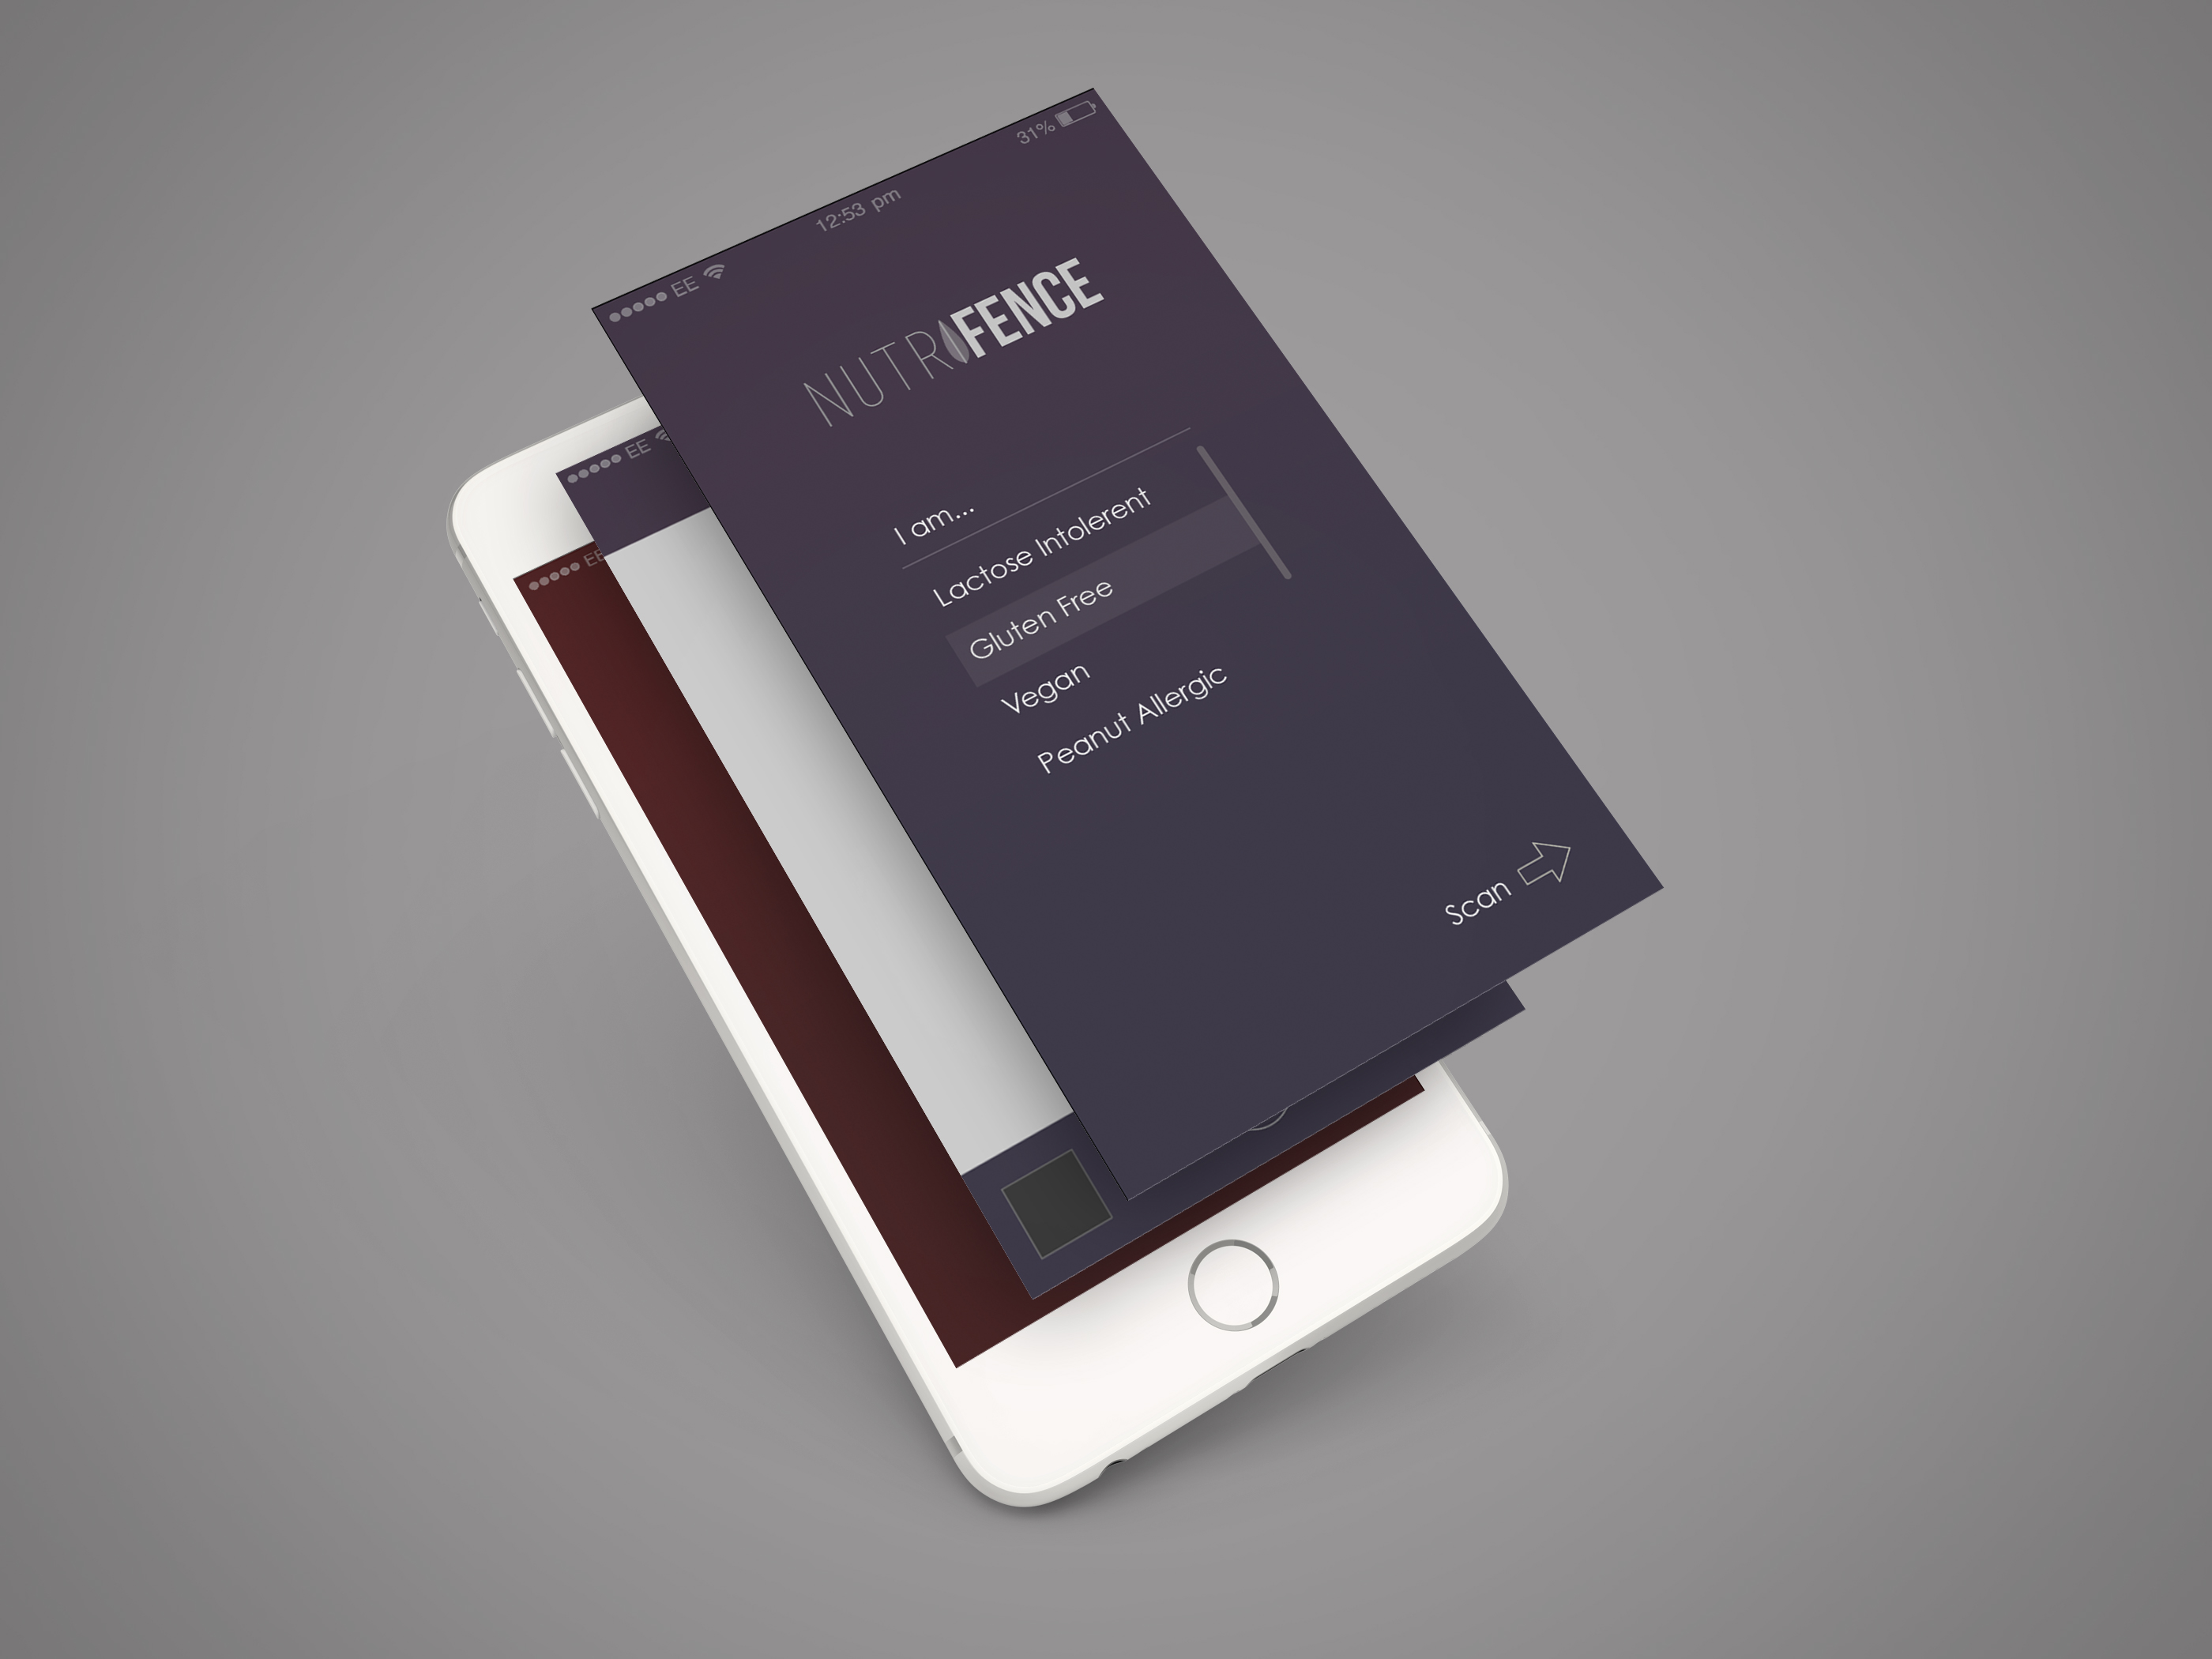

Slide 3
A fast and easy way to scan ingredients

Slide 4
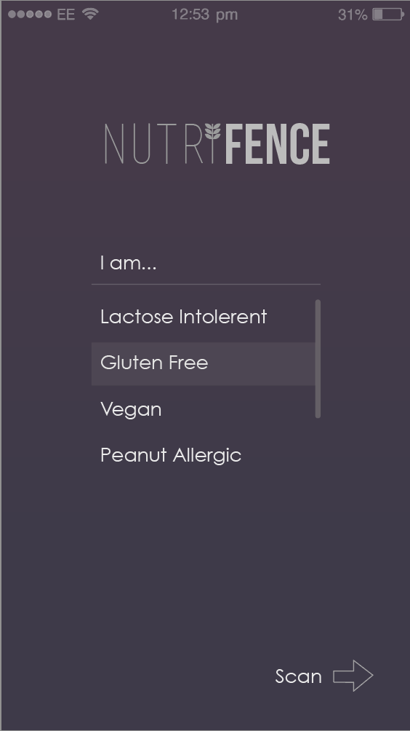
To get started, simply choose from the existing library of food related problems that you face, or customize your own.
*Concept

Slide 5
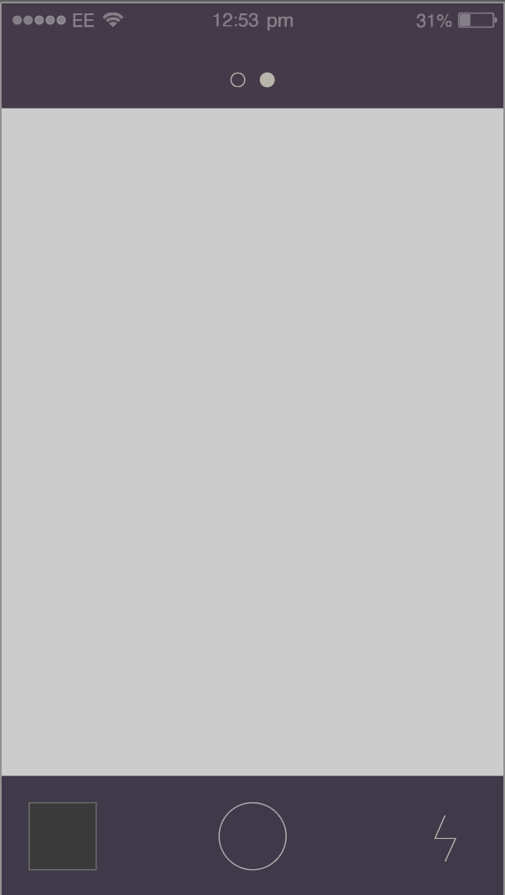
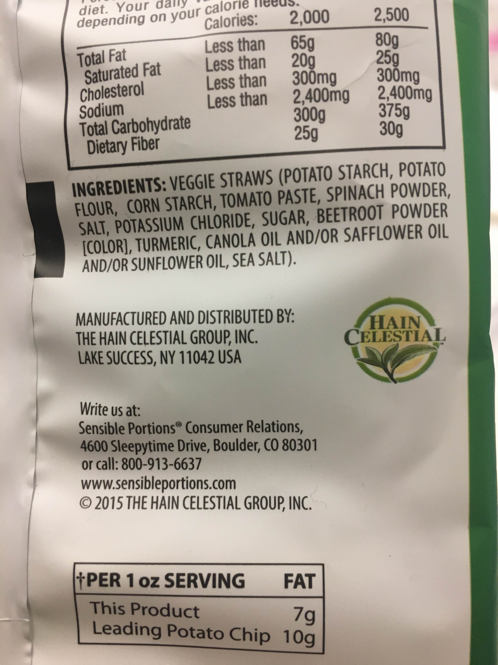
Next, take a snap of the ingredients directly from the product’s package.
Or choose to import from your own photo library.

Slide 6

One moment please,
Your data is being processed.

Slide 7
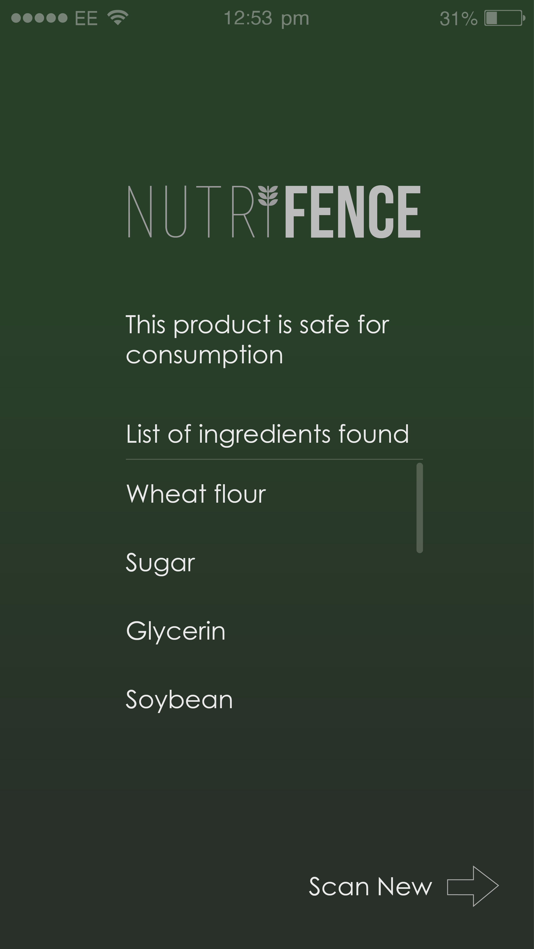
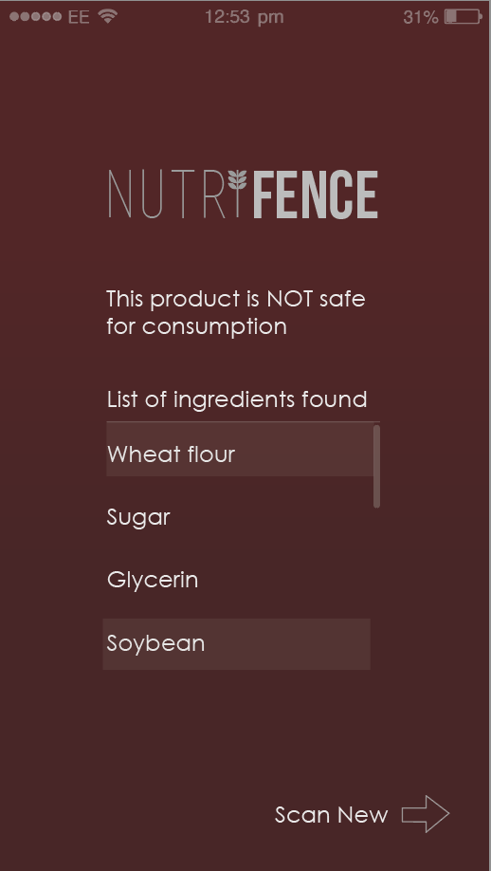
…here you go

Slide 8
It’s simple

Slide 9
And we are just getting started…

Slide 10
Medical Dietary needs
Celia Disease
Gluten Intolerance
Food Allergies
Vegan and vegetarian diets
Pescetarian
Belief based diets
Islamic dietary laws
Kosher diet
Diabetic diet
…

Slide 11
Thank you

